Slide 1
DISCRETE MATHEMATICS
Lecturer : Ngeth Youdarith & PHANN Sopheap
Group : 2
Group Member’s Name:
Na Sreypich
Toch Sreynit
Hong Chhievguek
Pen Kanha
Phy Sokmanea
Boa Mouyly
Deob Doungsopanha

Slide 2
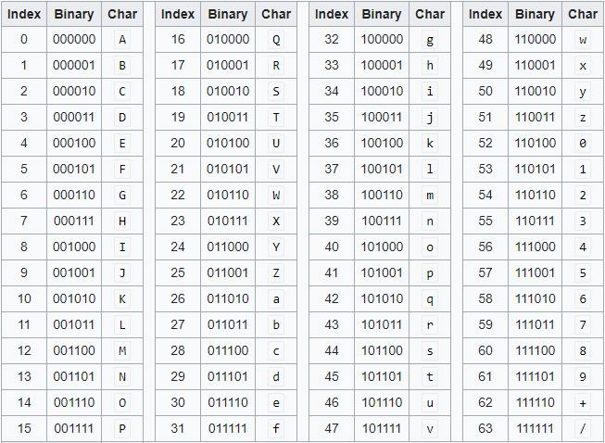

Exercise Practies
5. Convert the following into Binary
b. ${\text{(1}\text{FD}\text{53}\text{h}\text{)}}_{64}$
Solution:
Convert each digits to a 6-bits Binary value
we have
1=53=110101
F=5=000101
D=3=000011
5=57=111001
3=55=110111
h=33=100001
Final Answer: ${\text{(1}\text{FD}\text{53}\text{h}\text{)}}_{64}={(110101000101000011111001110111100001)}_{2}$

